Slide 1
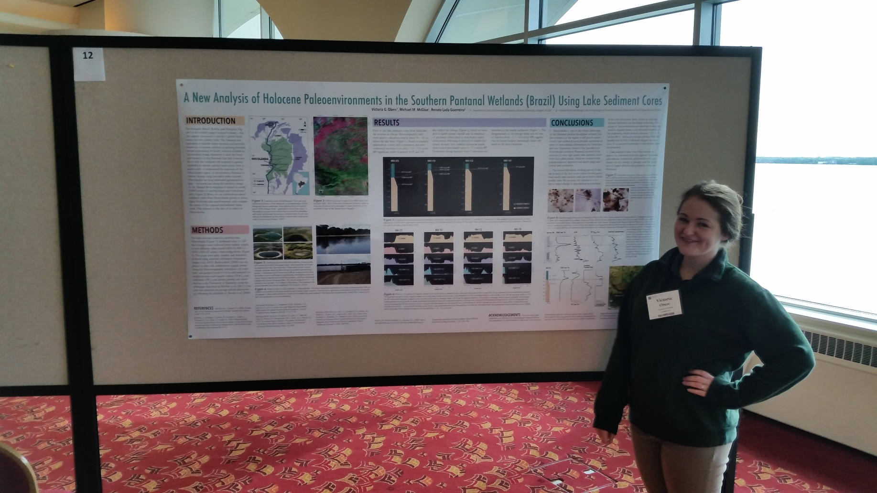
Undergraduate Research in Earth & Environmental Science
Student: Outgoing Geological Sciences major Senior Vic Oberc
Advisor: Dr. McGlue
Presentation: A new Analysis of Holocene Paleoenvironments in the Southern Pantanal Wetlands (Brazil) using lake sediment cores
Occasion: North Central Section of the Geological Society of America, May 20, 2015
Vicki is the first UK EES Alumni Undergraduate Research Fellowship winner to present her research!

Slide 2
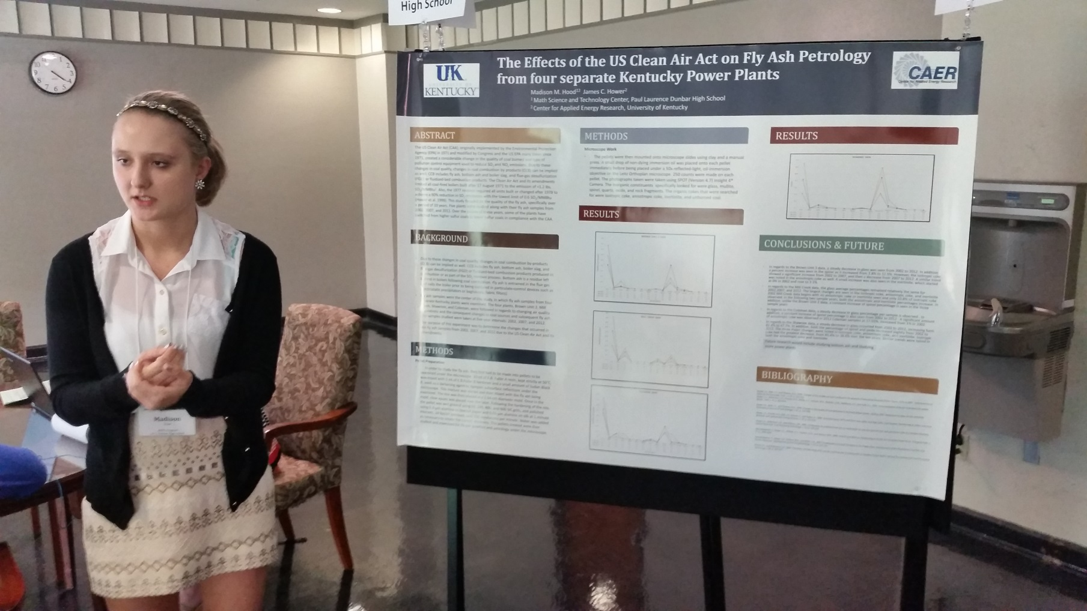
Undergraduate Research in Earth & Environmental Science
Student: Incoming Geological Sciences major Freshman Madison Hood
Advisor: Dr. Hower
Presentation: The Effects of the US Clean Air Act on Fly Ash Petrology from Four Separate Kentucky Power Plant
Occasion: UK Showcase for Undergraduate Scholars, April 24, 2015
Madison is the 2015 incoming freshman Pioneer Scholar in EES!

Slide 3
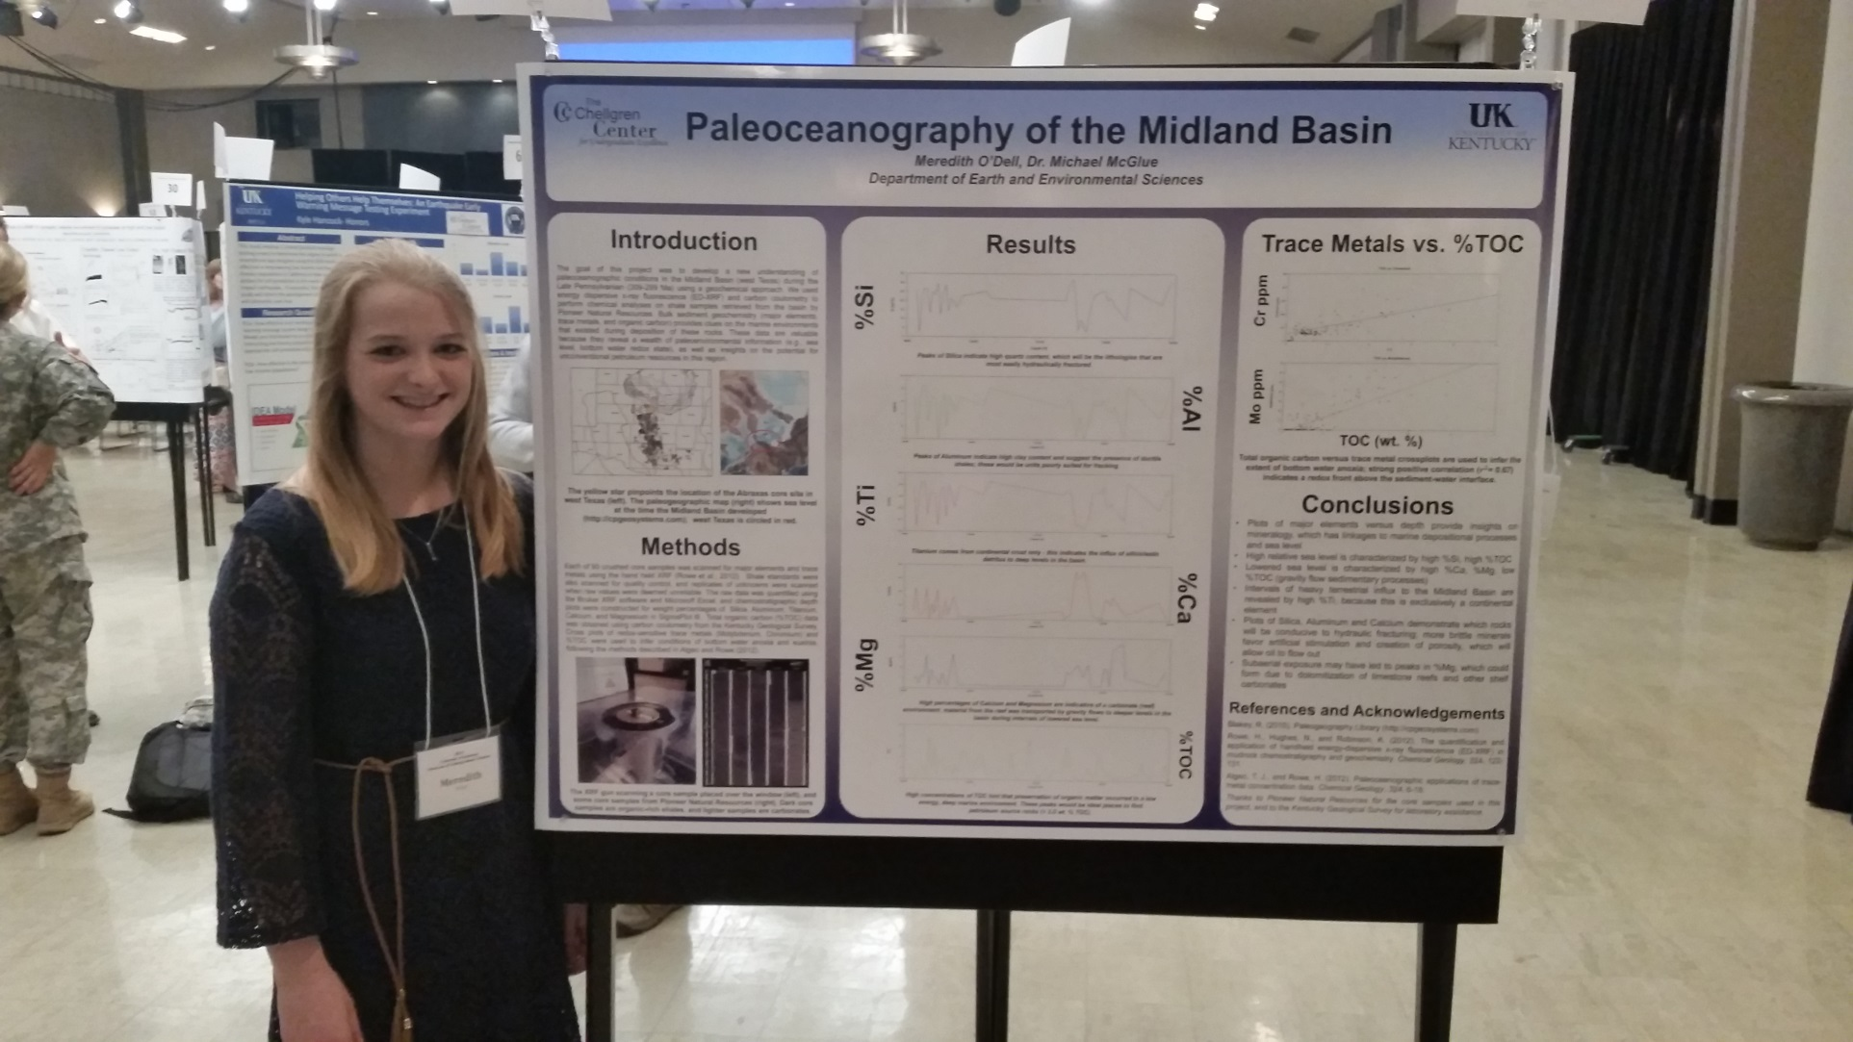
Undergraduate Research in Earth & Environmental Science
Student: Junior Geological Sciences major Meredith O’Dell
Advisor: Dr. McGlue
Presentation: Paleoceanography of the Midland Basin
Occasion: UK Showcase for Undergraduate Scholars, April 24, 2015
Meredith did her research as a Chellgren Fellow!

Slide 4
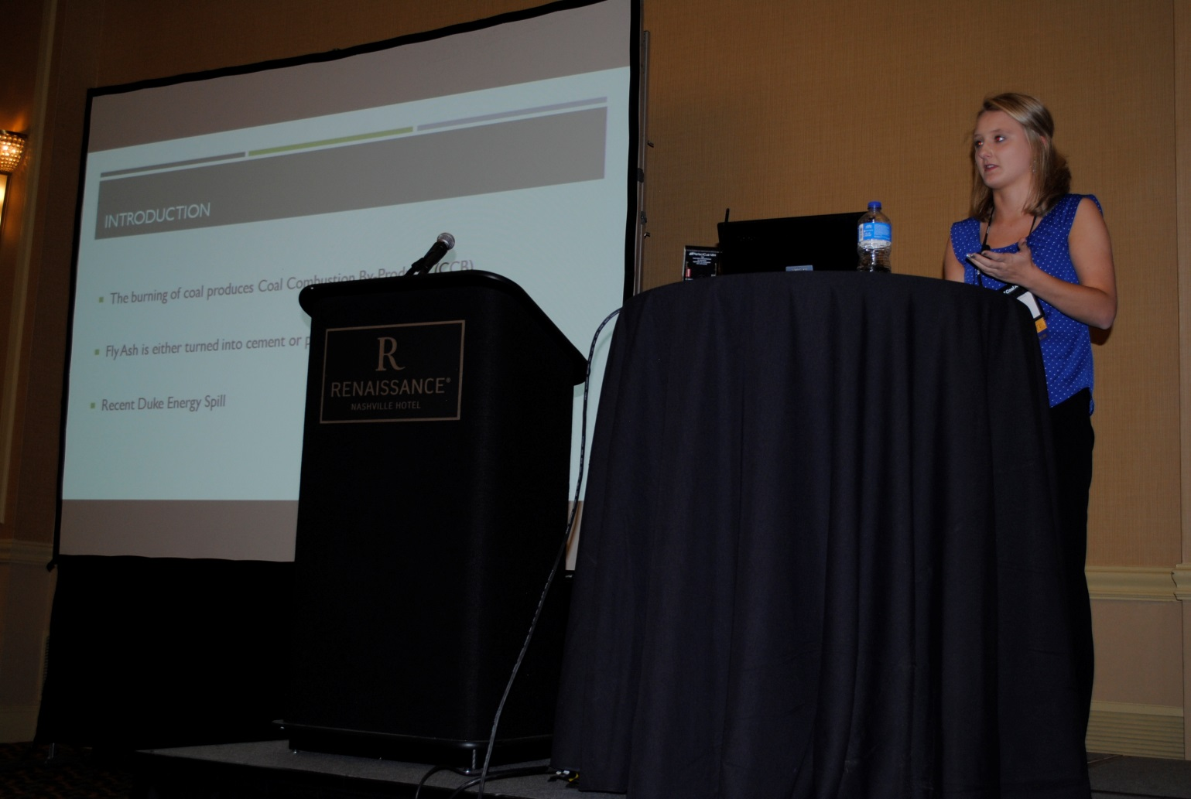
Undergraduate Research in Earth & Environmental Science
Student: Incoming Freshman Geological Sciences major Madison Hood
Advisor: Dr. Hower
Presentation: Impacts of Changes in Coal Supplies and In Environmental Controls on Fly Ash Petrology and Chemistry
Occasion: World of Coal Ash Conference, May 7, 2015
Madison presented at an international conference!

Slide 5
Undergraduate Research in Earth & Environmental Science
UK professor!
UK Alum and Morehead State professor!
UK freshman!

Slide 6
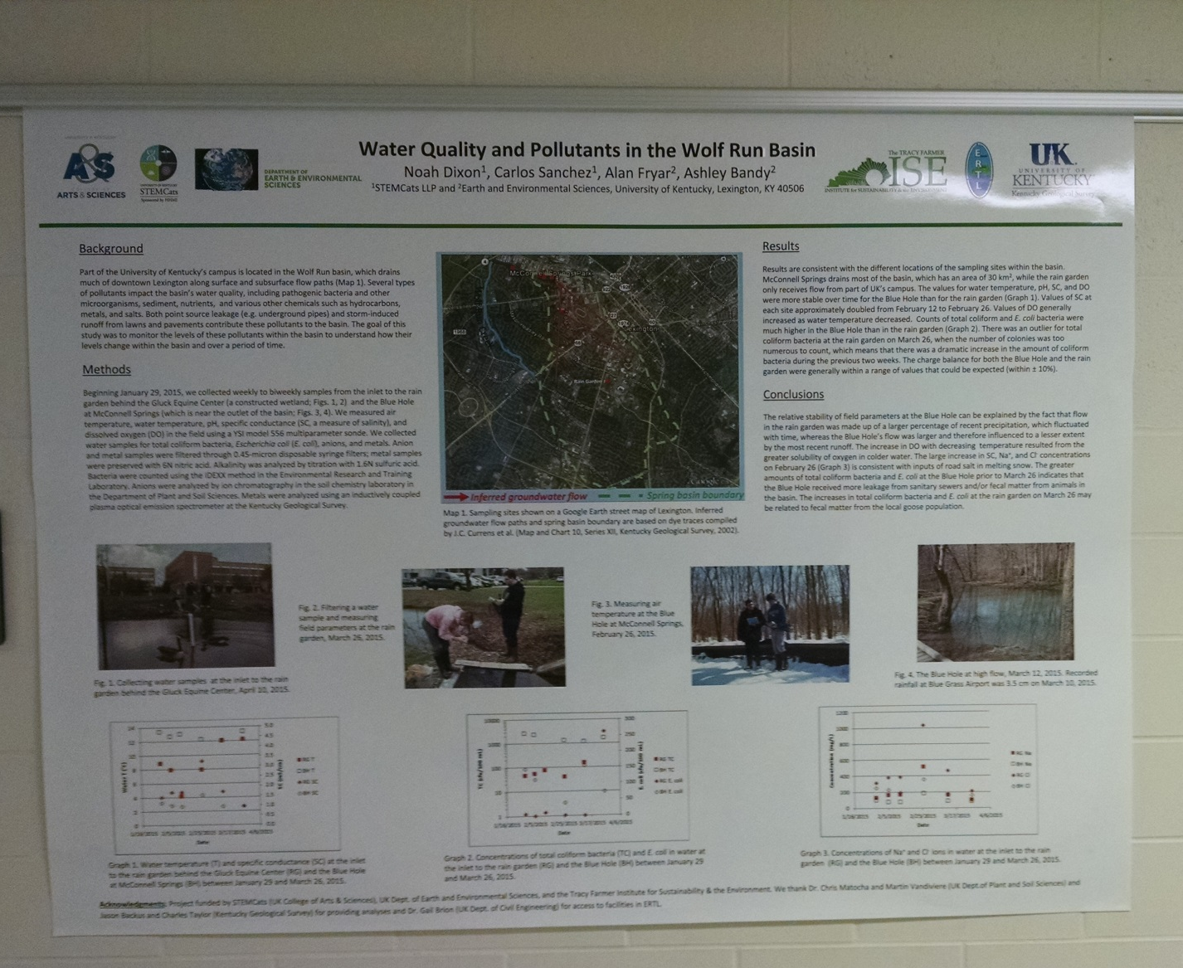
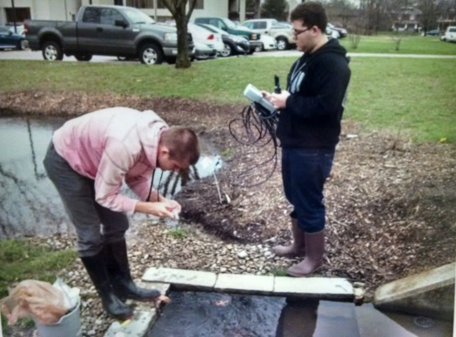
Undergraduate Research in Earth & Environmental Science
Student: Sophomore Biology/Geological Sciences major Noah Dixon
Advisor: Dr. Fryar
Presentation: Water Quality and Pollutants in the Wolf Run Basin
Occasion: UK Showcase for Undergraduate Scholars, April 24, 2015
Noah and Carlos Sanchez worked with Ph.D. student Ashley Bandy in doing this STEMCAT research project

Slide 7
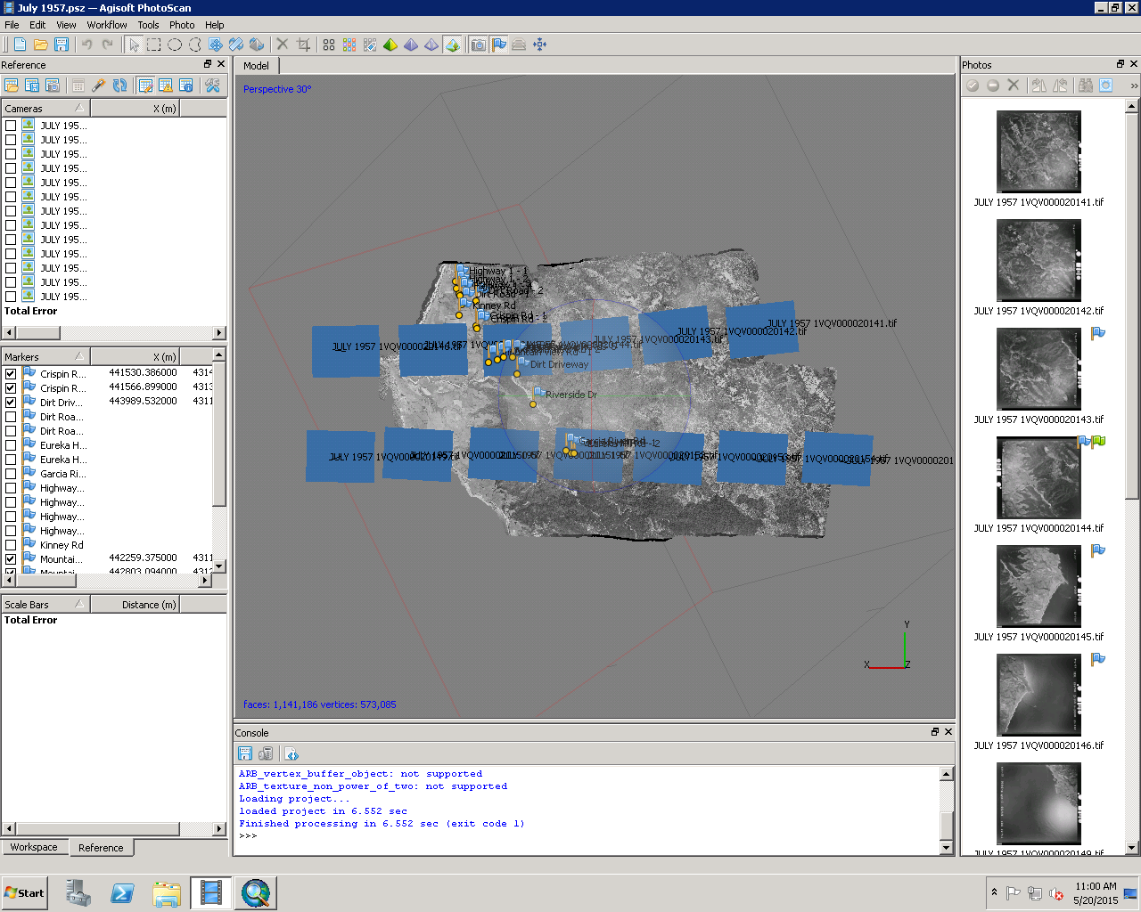
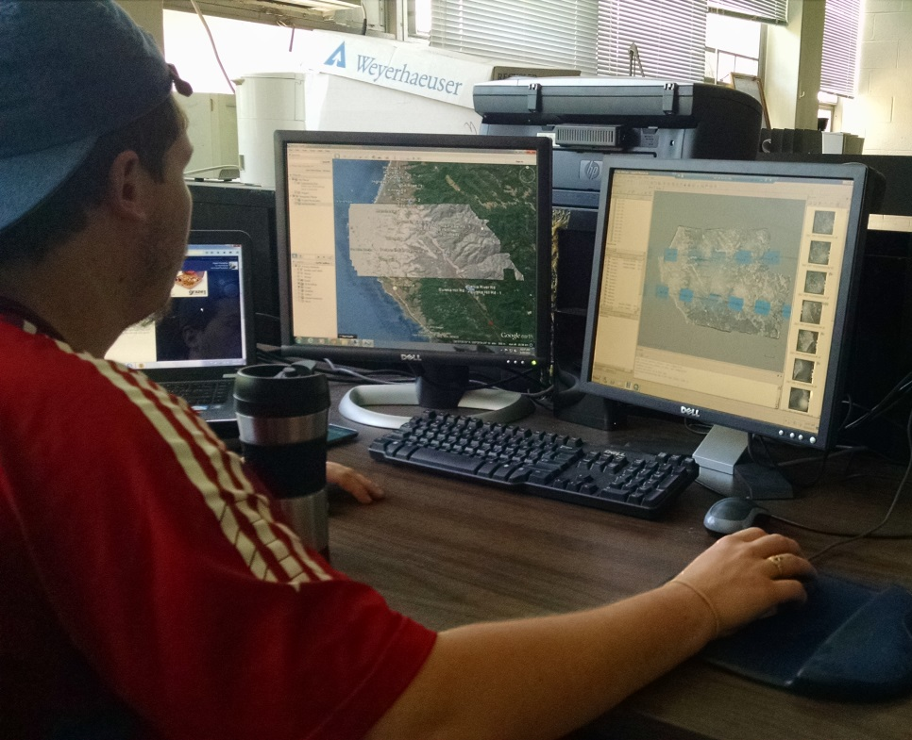
Undergraduate Research in Earth & Environmental Science
Student: Senior Geological Sciences major Sean Rohrer
Advisor: Dr. Bemis
Project: Can Interseismic Strain Accumulation be Extracted from Anaysis of Crustal Movement Perpendicular to Faults through DEMs and LiDAR Data?
Sean is a UK EES Alumni Undergraduate Research Fellowship winner!
“This is a DEM I made on Agisoft Photoscan using aerial imagery. The program uses an extremely long algorithm to create thousands of tie-points on each image and find where they overlap. The varying angles that each photo was taken from and an overlap with all adjacent photos of the area allows the program to produce the 3-D model.”

Slide 8
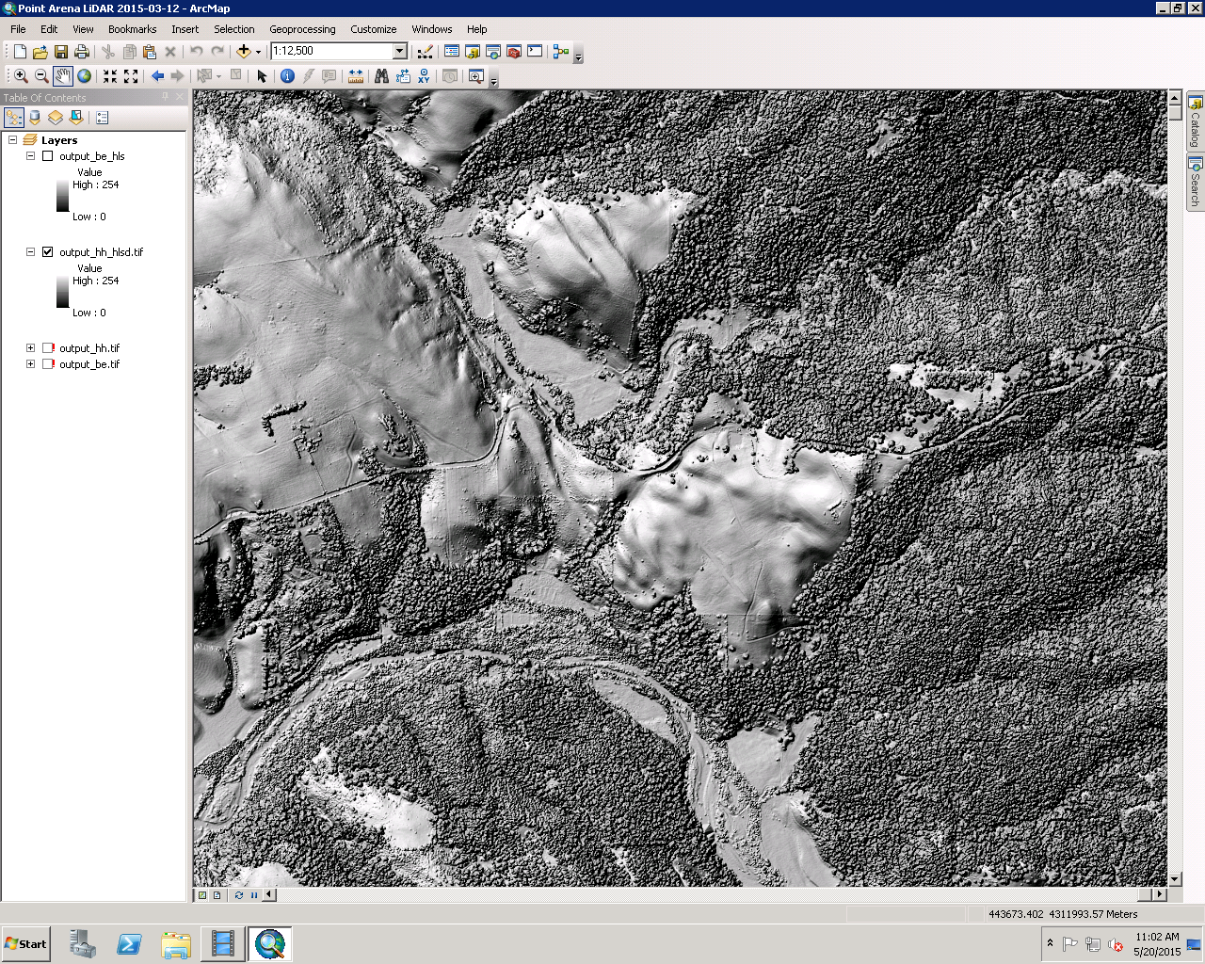
Undergraduate Research in Earth & Environmental Science
Student: Senior Geological Sciences major Sean Rohrer
Advisor: Dr. Bemis
Project: Can Interseismic Strain Accumulation be Extracted from Anaysis of Crustal Movement Perpendicular to Faults through DEMs and LiDAR Data?
Sean is a UK EES Alumni Undergraduate Research Fellowship winner!
“This is a DEM produced via LiDar data on CloudCompare. The data has been rasterized, and I’ve transferred the file to an ArcMap file and am extracting (x,y,z) coordinates in order to orient the other DEM. Once all the coords have been extracted, I’ll lay both pointclouds on top of each other and hopefully interpret strain accumulation from crustal motion perpendicular to the fault.”

