Slide 1
College of Arts & sciences
Outstanding Staff Awards

Slide 2
2019 A&S Staff Council
Drew Lane (Chair)
Becca Roark (Co-Chair)
Sydney Baker (Secretary)
Megan Bowles
Max Brown
Jason Carr
Kristen Pickett
Suann Reese
Diane Riddell

Slide 3
Dean Kornbluh

Slide 4
5 years of service
Kristen Aitkin
Jason Carr
Bradley Harrington
Devin Klaserner
Megan Koshurba
Jennifer Owen
Jessica Pennington

Slide 5
10 years of service
Rita Basuray
Kari Burchfield
Emily Denehy
Peter Idstein
Alaa El Mediouri
Sarah Paddock
Edmund Rucker
Michelle Schardein
Mohammed Shammisaldeen
Stacey Slone
Daniel Whittaker
Joe Wiley
Nijad Zakharia

Slide 6
15 years of service
Jamie Brown
Melissa Cowan

Slide 7
20 years of service
Mike Adams
Brian Doyle
Michael Stottman

Slide 8
25 years of Service
Kimberly Reeder

Slide 9
30 years of Service
Christine Levitt
Stacey Wilks

Slide 10
35 Years of service
Art Sebesta

Slide 11
Thank you for your years of service to the University of Kentucky and the College of Arts & Sciences!

Slide 12

Outstanding Staff Awards

Slide 13
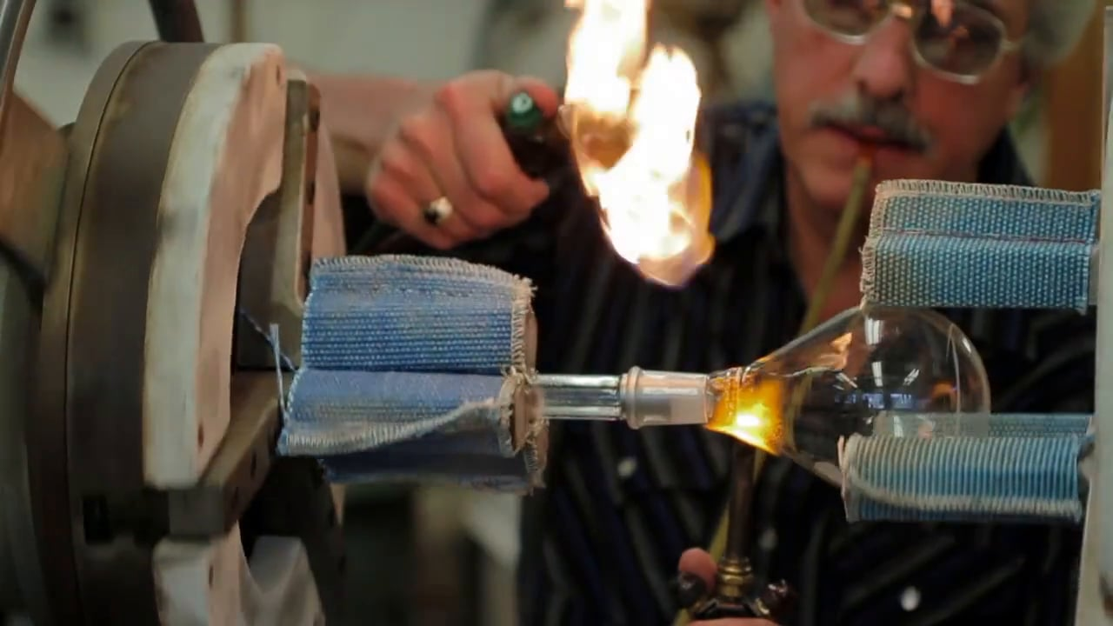
Thank You Jeff Babbitt

Slide 14
Mike Adams
“Because of his roots and his love for UK, Mike is fully vested in and a staunch advocate of student, departmental, College, and ultimately, University success. Consequently, he is always willing to go above and beyond what is required of his job to make sure everything is handled appropriately and in a thoughtful manner.”
“Every day, he takes a proactive rather that reactive stance to address facilities issues that will impact teaching, research, and ultimately, student success and the success of research activities.”

Slide 15
Catherine Brereton
“Whether confronting some of Lafferty Hall’s occasional plumbing and heating challenges or organizing complex departmental events, Catherine manages to carry off whatever needs to be done without ruffling any feathers or displaying even a moment’s distress.”
“Catherine has not only proved exceptionally competent at all the many routine tasks associated with this job, she has also been personable, humorous, and, most importantly, innovative in her approach.”

Slide 16
Max Brown
“His selfless devotion to our undergraduate and graduate students, coupled with his creative and innovative solutions to a number of problems with our curriculum and his tireless advocacy for the students in our department, far exceed what any of us would have either anticipated or expected when he was hired.”
“Max is also a trusted advisor to whom our undergraduate students turn for advice. In this regard, Max has been a fierce advocate for inclusivity within our department.”

Slide 17
Kari Burchfield
“Kari’s accuracy and attention to detail, impressive memory, and flexibility in accepting job duties benefit every department within the College. She is able to anticipate and mitigate issues by drawing upon her historical knowledge, organizational abilities, and critical thinking.”
“Kari’s dedication extends beyond her job responsibilities, though. She voluntarily drove to London and Corbin for recruiting events—activities that required her to be away from home until late at night.”

Slide 18
Jenny Casey
“She checked in on me several times a week and continues to help me; along with everybody in the department each and every day.”
“Jenny Casey shows amazing amount of dedication to the Psychology Department. As a new staff member in the department, Jenny has gone above and beyond in helping me get oriented.”

Slide 19
Melissa Cowan
“Melissa provides unwavering support in post-award management of grants.”
“She has always been extremely responsive, conscientious and very knowledgeable. Management of budgets, staffing etc among different funding agencies is nontrivial and without her help I could not get my work done.”

Slide 20
Michelle Del Toro
“Often I say it is she who is the department boss, and that is because she holds the authority and commands the respect of all with whom she works.”
“She is the epicenter and departmental memory/archive for questions, support, problem solving, anticipation, details, and emotional help of all sorts. She is patient with the endless stream of pesky questions as well as someone who is always open to helping us all regardless of how busy she is. She also worries for us.”

Slide 21
Adrianne Gilley
“Adrianne is the ‘Radar O’Reilly’ of the Department, i.e., like the character from the TV show ‘MASH’, she has the answer to a question or the solution to a problem before they are posed to her.”
“Adrianne’s exemplary service to our mission is demonstrated over and over again in her uncanny ability to see things that need doing, and seamlessly make them happen, sometimes receiving less credit than she is due, because she makes it look so easy.”

Slide 22
Andy Johnson
“He is always available via email or phone to help us sort through any shenanigans that arise.”
“I always know that I can turn to Andy with any questions or problems and he will be able to help or suggest an alternative idea.”

Slide 23
Devin Klaserner
“Devin is the type of person who will show up early for work without complaint and stay late without a thought, just to ensure the best possible setup for the TAs and students.”
“His allegiance to his coworkers and his desire to serve the department is apparent to everyone he meets here. I doubt that I would have been nearly as successful in my role without Devin's guidance and patience, as well as his overall competence.”

Slide 24
Brooke Kuerzi
“She is always nice and courteous and very professional in dealing with all the students, even the contentious and demanding ones.”
“She also manages all the Biology and Neuroscience research contracts and obtains the grades from mentors all across campus to make sure the Bio395 and Bio394 grades are submitted on time and works with those faculty across campus in the paperwork involved with the student research contracts. I really do not know what we would do in Biology and Neuroscience without her.”

Slide 25
Christine Levitt
“Having someone that I know I can communicate with in the Math department easily takes a weight off my shoulders, so I know when there's an issue I can always talk it through with Christine and we can get it figured out.”
“While I could go on and on Christine’s professionality and collegiality, her efficiency and effectiveness in handling needed beaurocratic tasks, etc, I’ll sum up by saying that Christine Levitt is truly among the most important members of the UK Mathematics department.”

Slide 26
Scott May
“Scott's work on our interactive content has pushed the college of A&S into the forefront of Interactive marketing on campus and made us a leader that other areas now look to for inspiration and direction as the rest of the University moves in this direction.”
“Scott is extremely professional, his skills and knowledge are a very big asset to the Hive web team and to the College of A&S.”

Slide 27
Steven Maynard
“Although the machine shop is staffed by three machinists, over the years Steve has proven himself to be the most skilled, efficient, and quickest to adapt to new and emerging technologies.”
“Researchers in our department, and in multiple departments across the College, would not be in a position to deliver on their research projects without Steve’s leadership of the machine shop. His work has also had an enormous impact on the department’s teaching mission, through the fabrication of unique demonstration equipment.”

Slide 28
Jordon munizzi
“During 2018 and into today, Dr. Munizzi has taken the laboratory from limited functionality to a nationally recognized facility.”
“Dr. Munizzi is passionate about his work, a pleasure to work with, and has been critical to my professional success this past year. He has blown away my expectations, and deserves recognition for his exceptional effort and success.”

Slide 29
David nealis
“David has done a great job of moving from a student position into a full-time staff position and dealing with all of the additional responsibility that comes with it. David is very well liked by users in the Biology department as well as around the rest of the college and is respected by his colleagues within the Hive.”
“David is an extremely hard worker, follows the rules, and is extremely dependable. I'm very happy that we were able to hire David and keep him here within the College, he is an asset to the Biology Dept, the College and the University.”

Slide 30
Diane Riddell
“Diane's responsibilities are numerous and never-ending but she is able to handle all of them with skill and focus.”
“She continually works to encourage others, provide help when needed, make invaluable suggestions, and displays a positive attitude. When people walk into the Physics and Astronomy main office or call on the phone they are greeted warmly and professionally; Diane uses exceptional customer service skills to make everyone feel welcome and valued.”

Slide 31
Pam Thompson
“She is admired for her understanding of policies & procedures and often sought out to participate in new initiatives or to gain feedback on existing processes.”
“One of the things I admire most about Pam is that her mentoring style is not just to tell you how to accomplish a particular task, but she also explains why and how it fits into the bigger picture, so it makes more sense to you. She is one of the most organized, efficient, and hard-working people I know.”

Slide 32
Stacey Wilks
“Stacey has a reputation as a "go-to" person in the Business Unit. It's a very complicated and multi-faceted job, but Stacey is always happy to help and to find a way to make the impossible possible. I have enjoyed working with her throughout my time at UK.”

Slide 33
2018 Nominees
Mike Adams Catherine Brereton Max Brown
Kari Burchfield Jenny Casey Melissa Cowan
Michelle Del Toro Adrianne Gilley Andy Johnson
Devin Klaserner Brooke Kuerzi Christine Levitt
Scott May Steven Maynard Jordon Munizzi
David Nealis Diane Riddell Pam Thompson
Stacey Wilks

Slide 34
Thank you to the nominators
Scott Bradley Jennifer Bradshaw Ben Braun Jason Carr Robin Cooper Elizabeth Crolley
Linda Elmore Andrea Erhardt Frank Ettensohn Rebecca Freeman Alan Fryar Tina Hagee
Jesse Hedge DaMaris Hill Pete Idstein Andy Johnson Peter Kekenes-Huskey Brooke Kuerzi
Sarah Lyon Liang Luo Carol Mason Mike McGlue Dave Moecher Addison Monroe
Kelvin O’Dell Keely O’Farrell Brad Plaster Christopher Pool D. Ravat Suann Reese Al Shapere
Laura Sutton Ryan Thigpen Mark Whitaker Jen White Joe Wiley Ed Woolery

Slide 35
2018 Outstanding Staff Award Winner
Michelle Del Toro
Video

Slide 36
2018 Outstanding Staff Award Winner
Pam Thompson
Video

Slide 37
Thank you for Coming!
Please join us in the JSB Atrium for lunch

